Slide 1





SAE : Data analysis, Reporting and Data visualization
Mme Canonne, M. Bureau, M. Garnier
Dawei Zhou Lola Dixneuf Alioune Diop Timéo Tessier Hugo Prouteau
Notes:
Lola

Slide 2

Introduction
Presentation of the project
Calyxis and Mavie
Our Goal
Given Data
Scrum Method & Computing tools
Scrum Method
Project management tool
Computing tool
Our Work
Filtering and analyses of the Data
Dynamic tool
Data visualization
Notes:
Lola

Slide 3
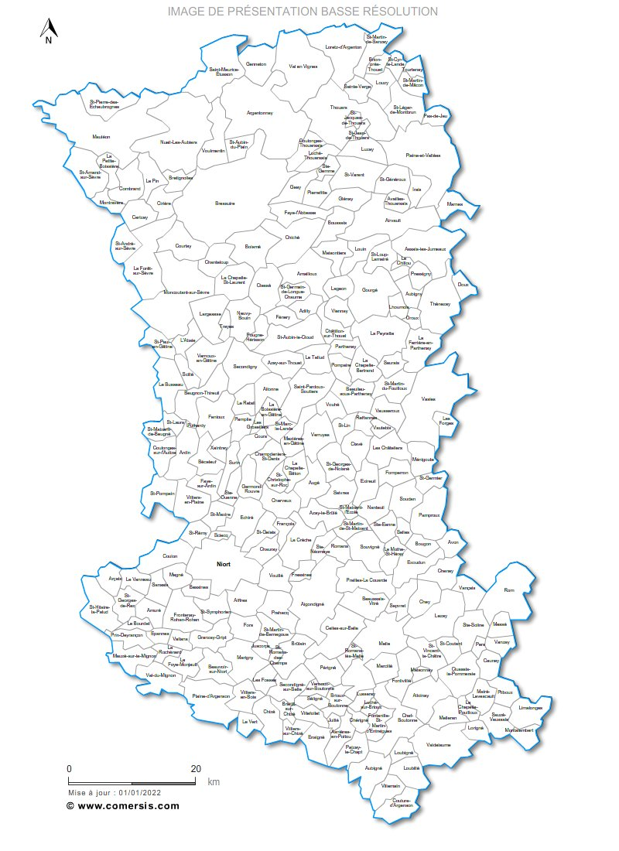
Presentation :
Presentation of Calyxis and Mavie
Our Goal
Dataset presentation
Scrum Method & Computing tools :
Scrum Method
Project management tool
Computing tools
Our Work:
Filtering and analyses of the Data
Dynamic tool
Data visualization with Power BI
Founded in 1977
History of Calyxis
Main goal :
To reduce the vulnerability of people against the everyday risks in 3 different domains
Everyday life accidents
Health and nutrition
Risks of flooding
Map of the Deux Sèvres territory
Notes:
Hugo

Slide 4
Presentation :
Presentation of Calyxis and Mavie
Our Goal
Dataset presentation
Scrum Method & Computing tools :
Scrum Method
Project management tool
Computing tools
Our Work:
Filtering and analyses of the Data
Dynamic tool
Data visualization with Power BI
The Mavie observatory
The everyday life accidents
Become a volonteer
+
What’s the point ?
To Collect
To Identify
To Suggest
Every year, about 24 000 people die due to an everyday life accident.
Notes:
Hugo

Slide 5
Presentation :
Presentation of Calyxis and Mavie
Our Goal
Dataset presentation
Scrum Method & Computing tools :
Scrum Method
Project management tool
Computing tools
Our Work:
Filtering and analyses of the Data
Dynamic tool
Data visualization with Power BI
Our Goal
What Calyxis Needed :
A better understanding of :
- The volunteers
- The victims of accidents
Our global guide line:
Filter and analyse the Data bases
Develop a dynamic and computing tool
Compare our data with external data
Notes:
Hugo

Slide 6
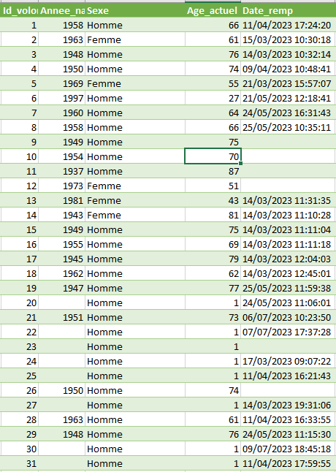
Presentation :
Presentation of Calyxis and Mavie
Our Goal
Dataset presentation
Scrum Method & Computing tools :
Scrum Method
Project management tool
Computing tools
Our Work:
Filtering and analyses of the Data
Dynamic tool
Data visualization with Power BI
Presentation of the Data Set
707 volunteers
Organised in « BD_3quest »
Personnal information
Household Information
Sample of the data set
Notes:
Hugo

Slide 7
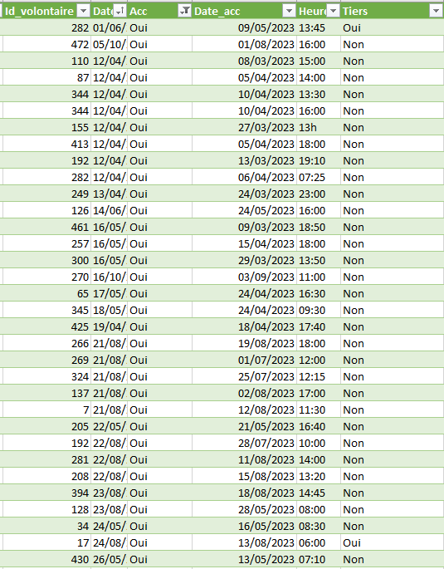
Presentation :
Presentation of Calyxis and Mavie
Our Goal
Dataset presentation
Scrum Method & Computing tools :
Scrum Method
Project management tool
Computing tools
Our Work:
Filtering and analyses of the Data
Dynamic tool
Data visualization with Power BI
Presentation of the Data Set
Every 2 months
« Accident »
Occurrence of accident
Cause of accident
Injuries or inconfort
Every information stays anonymous
Notes:
Hugo

Slide 8
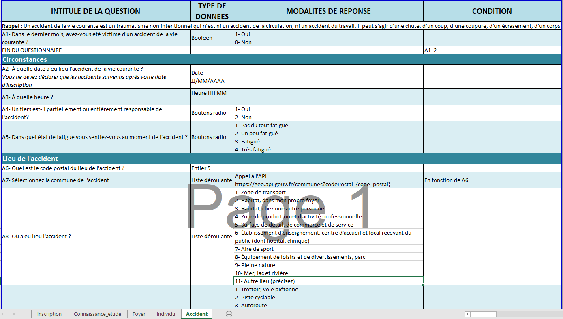
Presentation :
Presentation of Calyxis and Mavie
Our Goal
Dataset presentation
Scrum Method & Computing tools :
Scrum Method
Project management tool
Computing tools
Our Work:
Filtering and analyses of the Data
Dynamic tool
Data visualization with Power BI
Presentation of the Data Set
At their registration
Throughout the every two-month questionnaire
5 different spreadsheets
Notes:
Hugo

Slide 9
Presentation :
Presentation of Calyxis and Mavie
Our Goal
Dataset presentation
Scrum Method & Computing tools :
Scrum Method
Project management tool
Computing tools
Our Work:
Filtering and analyses of the Data
Dynamic tool
Data visualization with Power BI
Role Attribution
Product Owner
The Mavie Observatory
Professors
Developpement team
Dawei ZHOU (Scrum master)
Lola DIXNEUF (Dynamic tool)
Alioune DIOP (Filtering & analyses)
Timéo TESSIER (Data visualization)
Hugo PROUTEAU (External data)
End of sprint
Daily
Notes:
Dawei

Slide 10
Presentation :
Presentation of Calyxis and Mavie
Our Goal
Dataset presentation
Scrum Method & Computing tools :
Scrum Method
Project management tool
Computing tools
Our Work:
Filtering and analyses of the Data
Dynamic tool
Data visualization with Power BI
Product Backlog
Time management
Creation of an automated dynamic tool
Cartography/infographic to represent the French population
2 documentations accompanying the tool
An individual report
A collective report
A Power Point explaining the different researches and calculation (in English)
Filter the data
Find external data
Daily meeting :
One per day, before we start the day
Sprint planning :
Sprints of 3 days
What we did the day before
The difficulty we encountered
The help we need
What we are going to do today
Notes:
Dawei

Slide 11

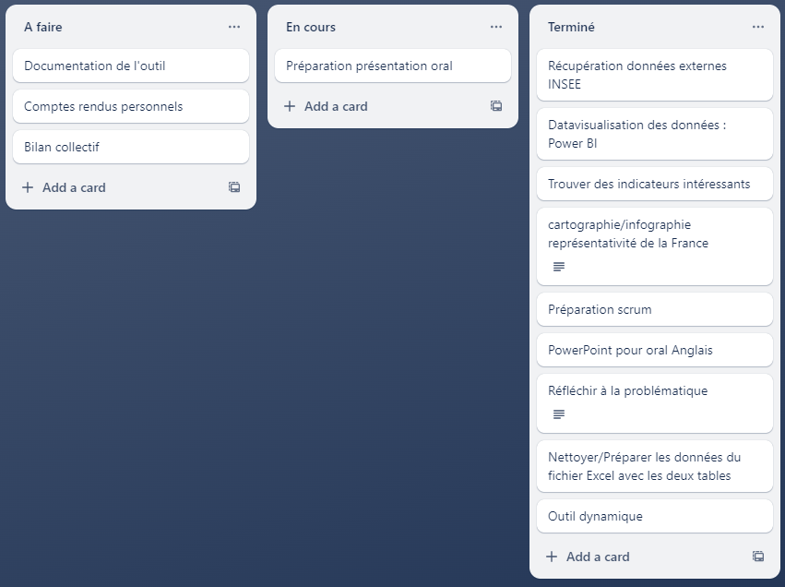
Presentation :
Presentation of Calyxis and Mavie
Our Goal
Dataset presentation
Scrum Method & Computing tools :
Scrum Method
Project management tool
Computing tools
Our Work:
Filtering and analyses of the Data
Dynamic tool
Data visualization with Power BI
Kanban Board
Trello
What we have to do
What’s in progress
What’s Finished
Notes:
Dawei

Slide 12


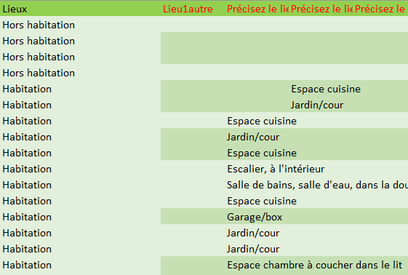
Presentation :
Presentation of Calyxis and Mavie
Our Goal
Dataset presentation
Scrum Method & Computing tools :
Scrum Method
Project management tool
Computing tools
Our Work:
Filtering and analyses of the Data
Dynamic tool
Data visualization with Power BI
The computing tools we used
Useful data
Inconsequential data
Excel :
Visualize usefulness of data
import external data
Power BI :
Data visualization
Efficient data filtering
Easy and suitable chart
Notes:
Lola

Slide 13


Presentation :
Presentation of Calyxis and Mavie
Our Goal
Dataset presentation
Scrum Method & Computing tools :
Scrum Method
Project management tool
Computing tools
Our Work:
Filtering and analyses of the Data
Dynamic tool
Data visualization with Power BI
The computing tools we used
R Studio ?
Python ?
Only one language
More confortable for the statistic part
Difficult Dynamic tool creation
Tkinter for Dynamic tool
Unknown Chi-square test
Which one ?
Notes:
Lola

Slide 14
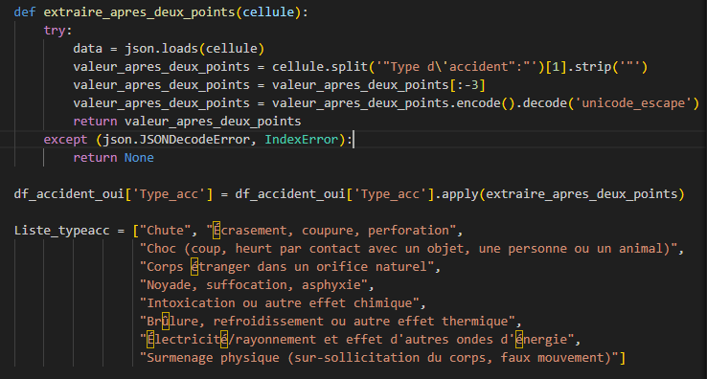
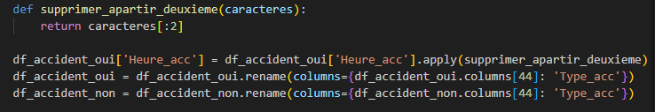
Presentation :
Presentation of Calyxis and Mavie
Our Goal
Dataset presentation
Scrum Method & Computing tools :
Scrum Method
Project management tool
Computing tools
Our Work:
Filtering and analyses of the Data
Dynamic tool
Data visualization with Power BI
Filtering the data
Delete useless data
Group & Organize
Read correctly the
«Type d’accident» colomn having encoding issues
Separate in two different spreadsheets the people who had an accident and those who didn’t
Notes:
Alioune

Slide 15
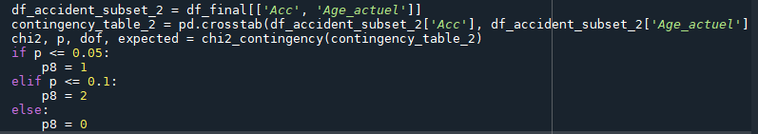
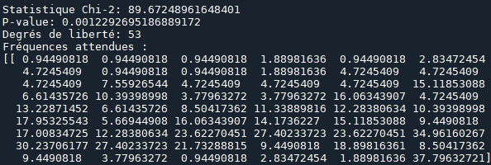
Presentation :
Presentation of Calyxis and Mavie
Our Goal
Dataset presentation
Scrum Method & Computing tools :
Scrum Method
Project management tool
Computing tools
Our Work:
Filtering and analyses of the Data
Dynamic tool
Data visualization with Power BI
Analyses of the data
One of the chi-square test we made
People who had an accident depending on their age
Chi-square tests : Corelation between the variables
Notes:
Alioune

Slide 16
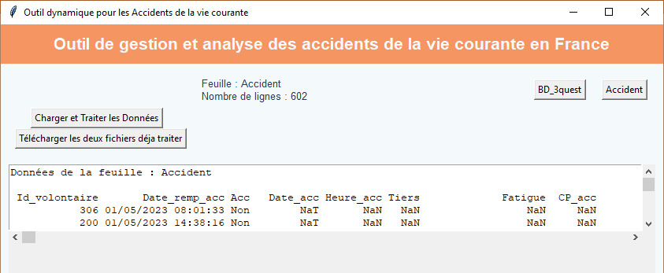
Presentation :
Presentation of Calyxis and Mavie
Our Goal
Dataset presentation
Scrum Method & Computing tools :
Scrum Method
Project management tool
Computing tools
Our Work:
Filtering and analyses of the Data
Dynamic tool
Data visualization with Power BI
The Dynamic tool
Searches for a data set and opens it
Exports the processed files
Change the spreadsheet
Visualize a part of your data set including different spreadsheets
Notes:
Lola

Slide 17
Presentation :
Presentation of Calyxis and Mavie
Our Goal
Dataset presentation
Scrum Method & Computing tools :
Scrum Method
Project management tool
Computing tools
Our Work:
Filtering and analyses of the Data
Dynamic tool
Data visualization with Power BI
Data visualization
How do everyday life accidents occur in France, how to remedy them?
Power BI
Notes:
Timeo

Slide 18
Conclusion and justification of our learnings
Conclusion
What works
Filtering and analyses of the data
Dynamic tool
Data visualization
External data
What we didn’t finish
Collective and individual report
Explaining tutorials
Notes:
Dawei

Slide 19
Conclusion and justification of our learnings
The Uses of programming
1.
A precise and nuanced communication in English
2.
What did we learn ?
Explaining the approach we have taken
3.
The uses of data visualization and infographic
4.
A prepared and clean data
5.
Notes:
Dawei, Lola, Hugo, Timéo, Alioune

Slide 20
Thank you for your attention!

